Slide 1
Bone histology- objectives
Parts of a long bone
Histological components of bone
Unique features of bone
Cell types in bone
Growth/ossification of bone
Disorders of bone

Slide 2
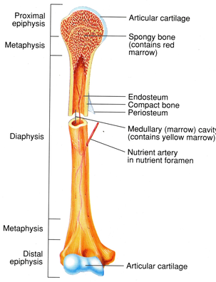
Parts of a long bone

Slide 3
Histological components of bone
Cells: osteoblasts, osteocytes, osteoclasts
Matrix: fibers and ground substance
Fibers: collagen type I
ground substance: chondroitin sulphate, keratan sulphate, hyaluronic acid, glucosamine
Sources of blood supply/nutrients to a long bone:
Muscle attachment
Periosteum
Nutrient foramen
Diffusion from synovial fluid

Slide 4
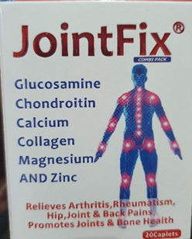

Slide 5
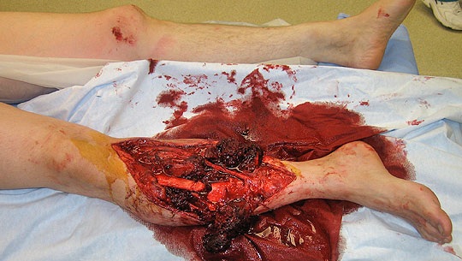
Open tibia fracture

Slide 6
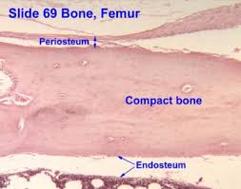
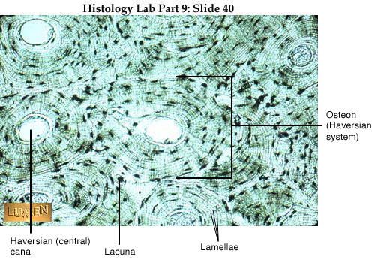
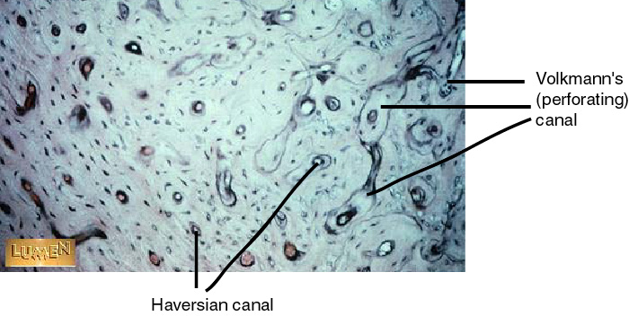
Unique features of bone

Slide 7
Phases of osteocytes
Resting phase
Formative/synthetic phase
Resorptive phase
Types of Ossification of bone:
Intramembranous (occurs in mesenchyme)
Endochondral (occurs in pre-existing cartilage)

Slide 8

The Major Players
Osteoblasts – build bone
Osteoclasts – break down bone tissue
Osteogenic cells – “highly mitotic” bone stem cells in membranes
Osteocytes – mature
bone cells in lacunae

Slide 9
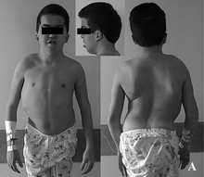
PAGETS DISEASE (formation of excess unmineralized bone)

Slide 10
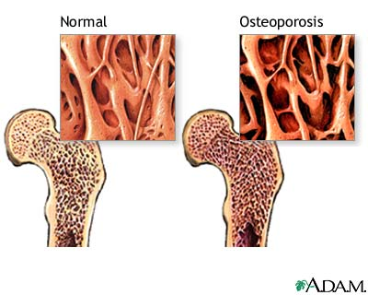

Slide 11
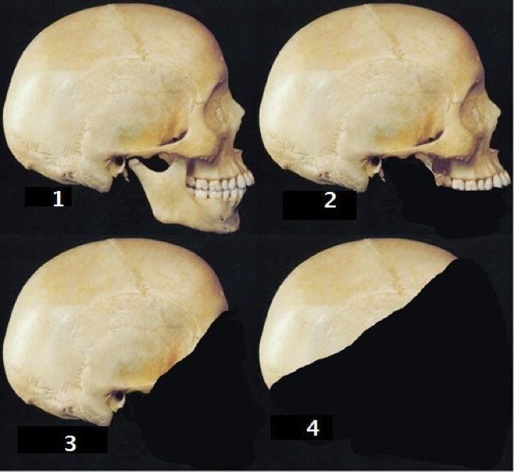
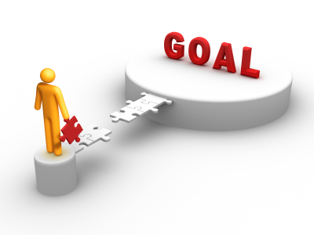
I. Intramembranous Ossification
End goal: Production of flat bones of skull and most of the clavicle.

Slide 12
Formation of the Bony Skeleton
Week 8 of pregnancy
fibrous membranes and hyaline cartilage begin to ossify.
Intramembranous ossification: development from fibrous membrane
Endochondral ossification: development from hyaline cartilage

Slide 13
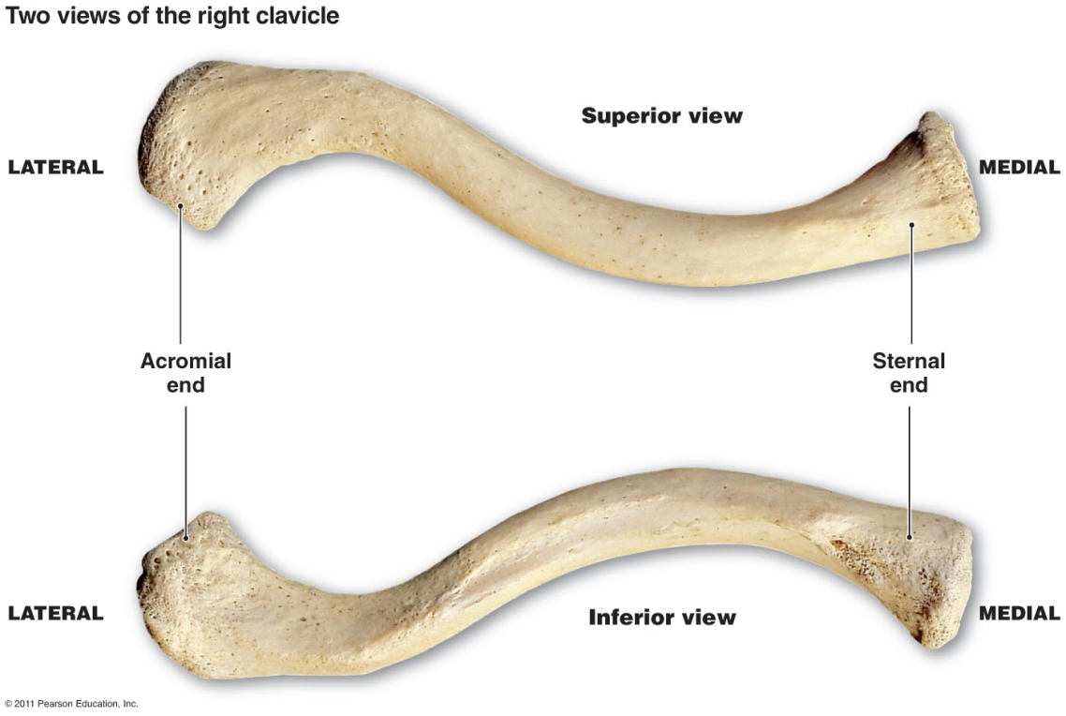
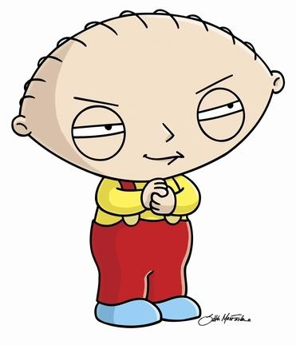
Intramembranous Ossification
Forms most bones of the skull and clavicles
All bones formed via this route ARE FLAT BONES
Fibrous CT from mesenchymal cells is the framework on which ossification begins

Slide 14
Four Major Steps:
STEP ONE
An ossification center appears in the fibrous
CT membrane
Mesenchymal cells cluster and become
OSTEOBLASTS→ forming ossification
center

Slide 15
Step Two
Bone matrix (osteoid) is secreted within the
fibrous membrane
-osteoblasts secrete osteoid (fibers and matrix)
-trapped osteoblasts become osteocytes

Slide 16
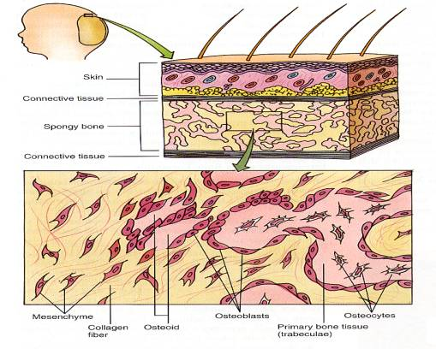

Slide 17
STEP THREE
Woven bone and periosteum form
-accumulating osteoid is laid down between embryonic blood, forming random network
-vascularized mesenchyme condenses on the external surface of the bone and forms periosteum

Slide 18
Step Four
Bone collar of compact bone forms and red marrow appears
-Trabeculae just deep to the periosteum thicken, forming a bone collar that will later be replaced by mature bone
-Spongy bone (diploe in flat bone), persist internally and its vascular tissue becomes red marrow

Slide 19
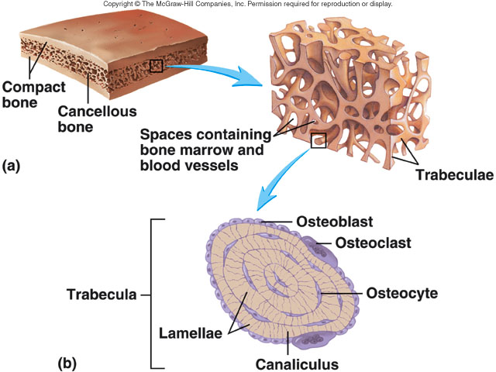

Slide 20
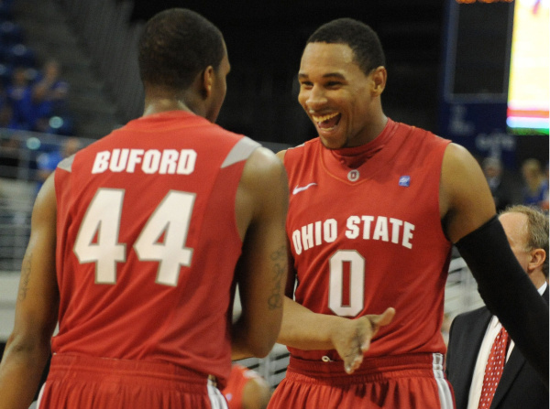
Endochondral Ossification

Slide 21
Fun facts
Begins in the second month of development.
More complex than intramembranous ossification
Begins in the center of long bone (which is made of hyaline cartilage at the time)
“primary ossification center”

Slide 22
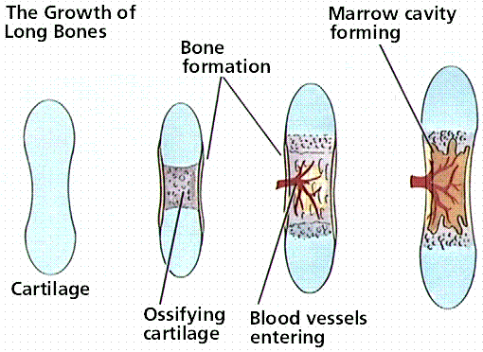

Slide 23
Step 1
Perichondrium becomes infiltrated with blood vessels
As a result→ osteogenic cells become OSTEOBLASTS
A BONE COLLAR FORMS AROUND THE DIAPHYSIS OF THE HYALINE CARTILAGE MODEL

Slide 24
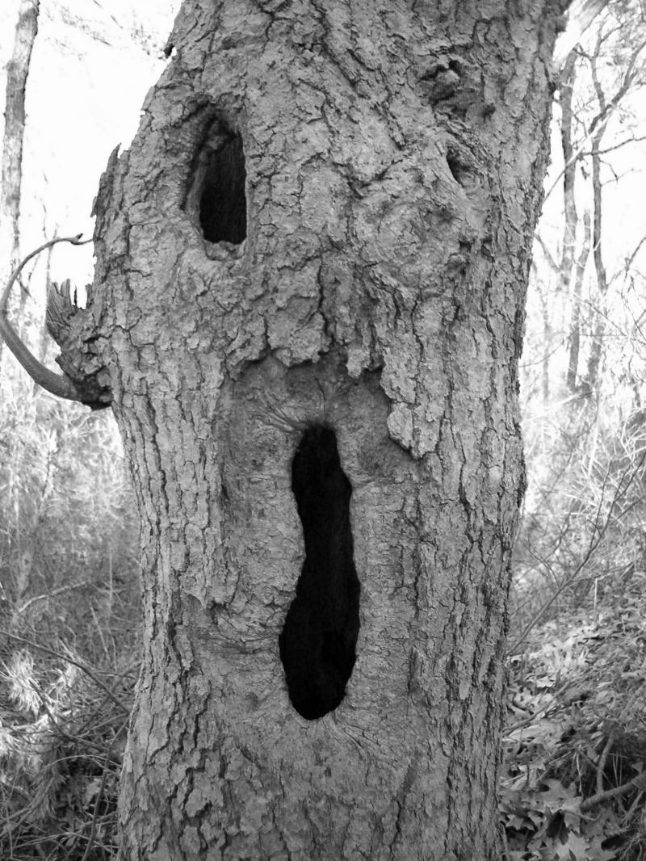
2
Cartilage in the center of the diaphysis calcifies
It then hollows out making a hollow cavity

Slide 25
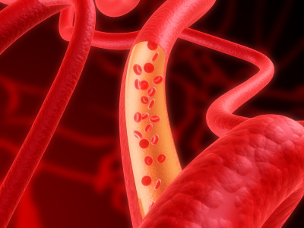
3
A periosteal bud invades the internal cavity
Periosteal bud consists of a network of arteries, veins, nerves and lymph vessels
This is what we see in the medullary cavity
Spongy bone forms

Slide 26
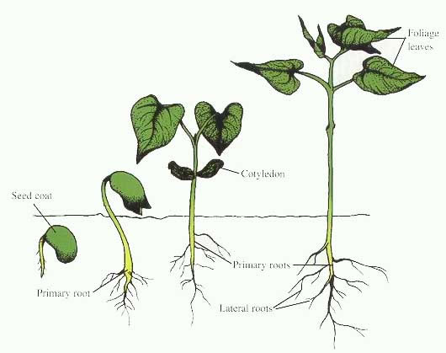
4
The diaphysis elongates in both directions and the medullary cavity increases in size

Slide 27
5
The epiphyses ossify. They generally receive their own ossification center

Slide 28
Postnatal Bone Growth
Infancy/youth→ long bones lengthen entirely by interstitial growth of the epiphysis
Growth in thickness→ appositional growth

Slide 29
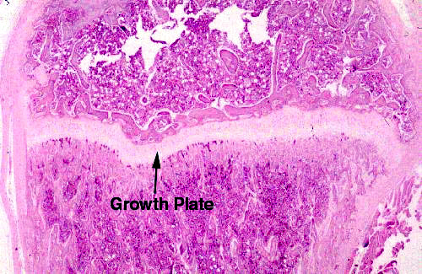

Slide 30
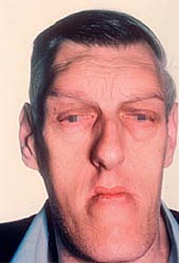
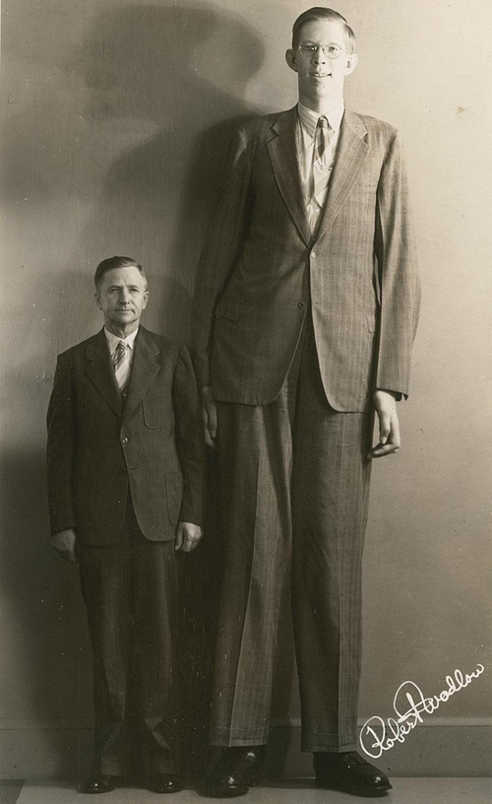
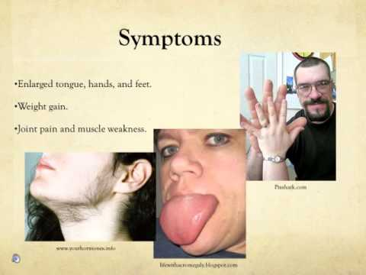

Slide 31
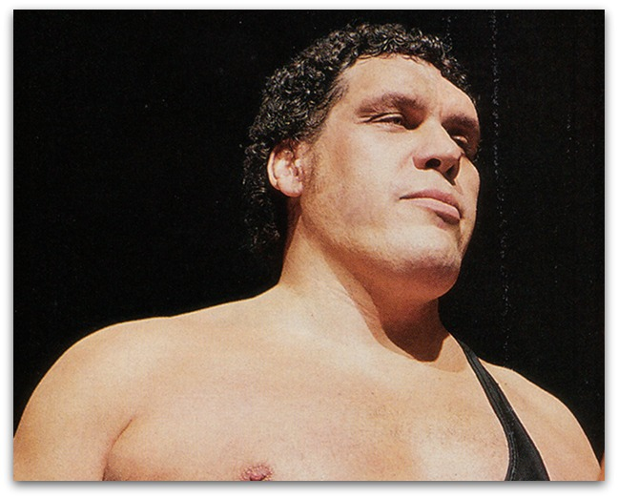

Slide 32
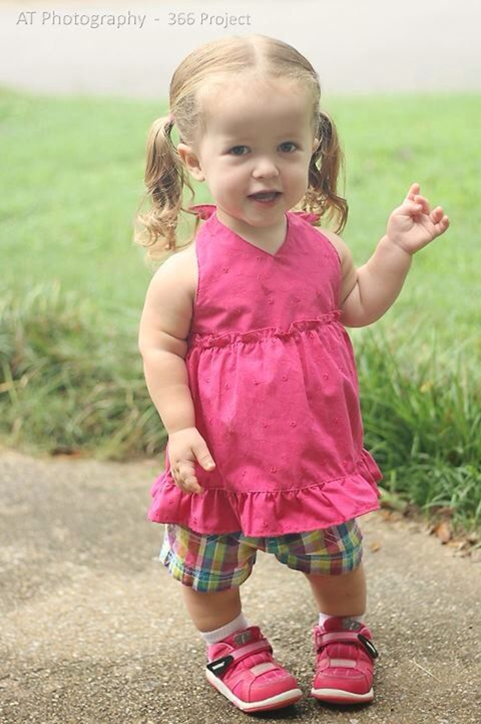
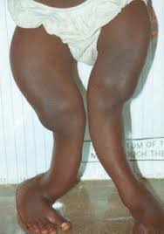
Disorders of bone/cartilage
Rickets
Achondroplasia

Slide 33
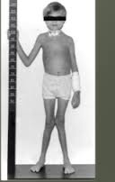
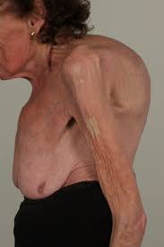
Renal osteodystrophy
Severe Osteoporosis

Slide 34
The end
Thank you

